Slide 1

Machine Learning Essentials (for Netflix Movies & TV Shows Dataset)
Classification • Clustering • Recommendation System
Presented by : Sultan & Daniyal Saeed | 56189 & 53937 Course : Machine Learning Essentials Semester Project Instructor : Sir Muhammad Imran Khan

Slide 2
Introduction to the Project

Slide 3
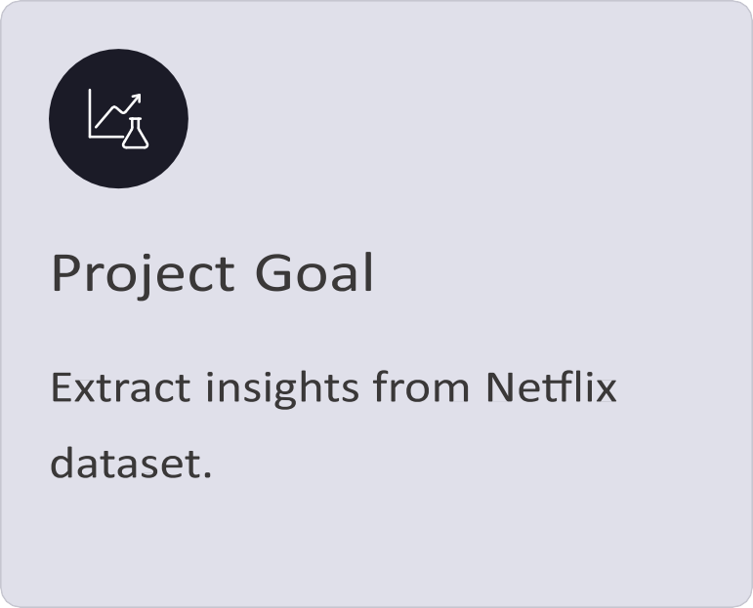
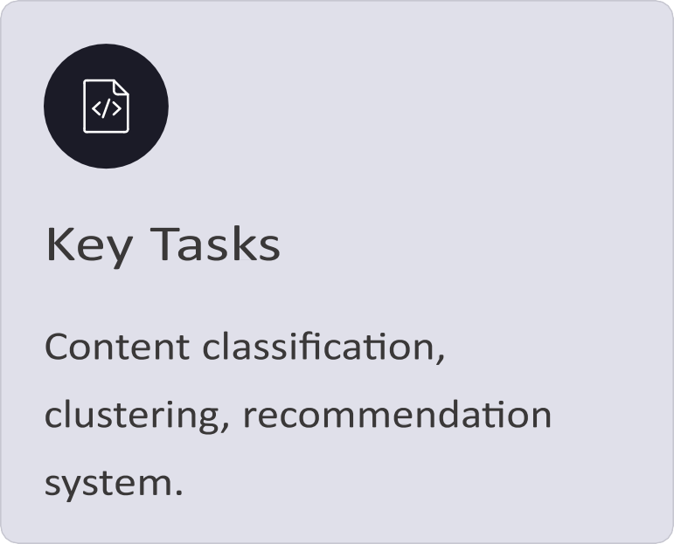
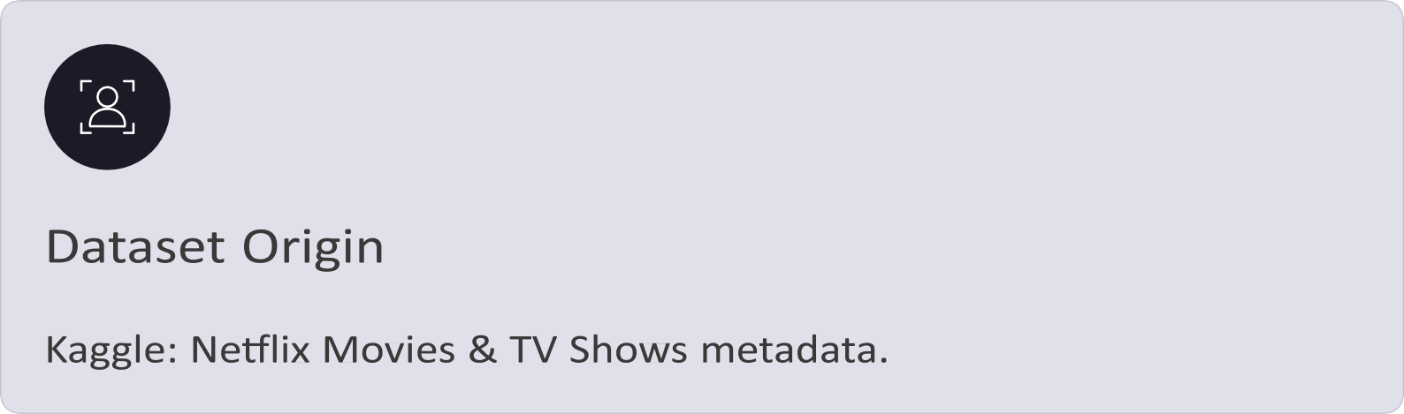

Slide 4
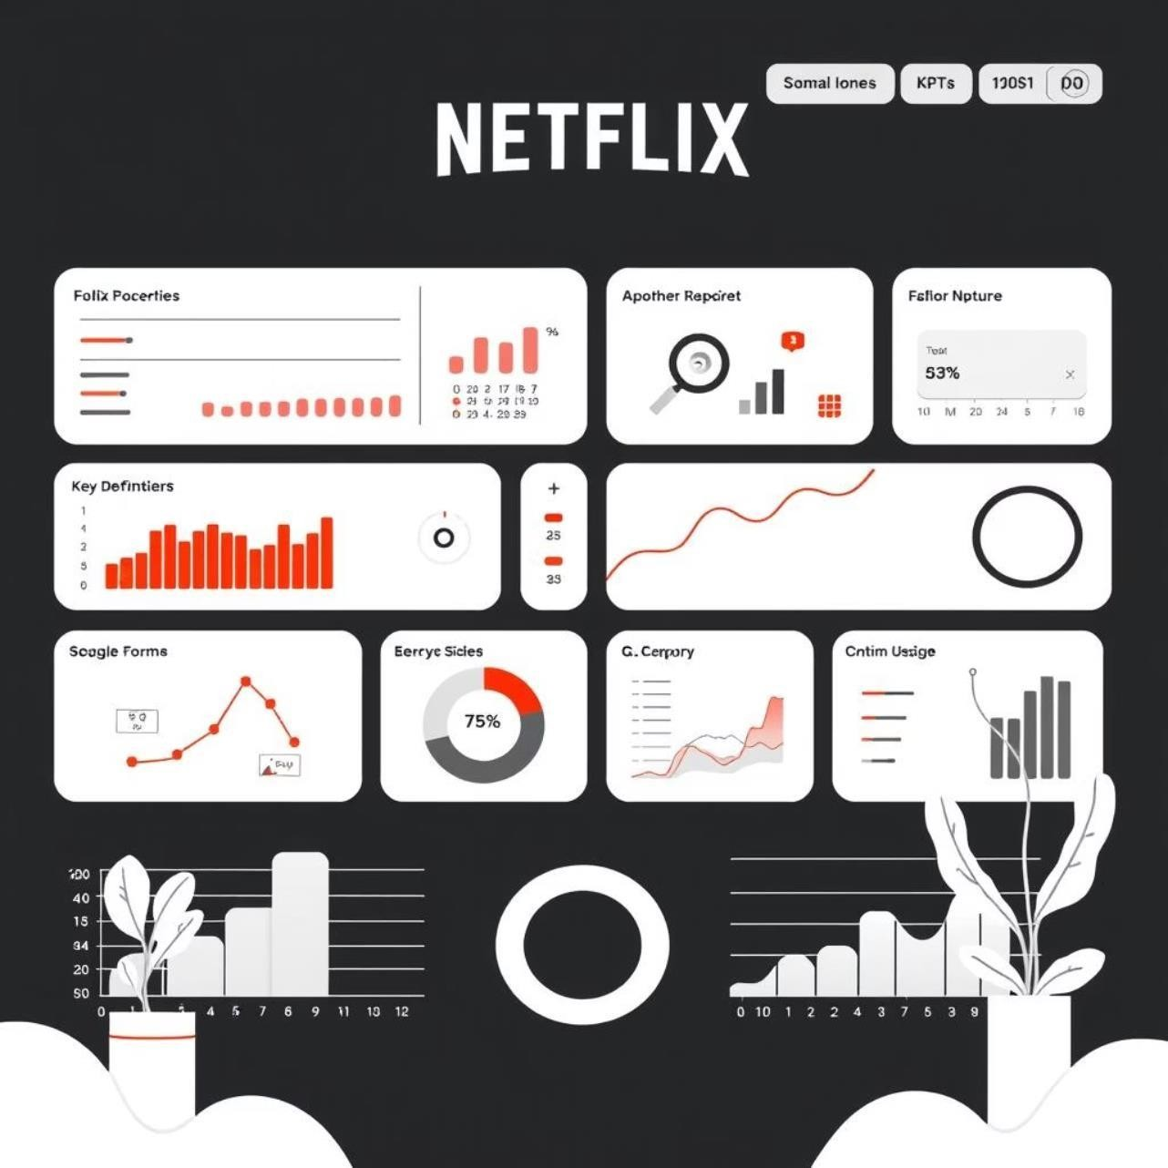
Understanding the Netflix Dataset
The Netflix dataset is a rich source of information, crucial for our analysis. It contains detailed metadata for each title.
Key Attributes: Title, type, director, cast, country, release year, rating, duration, genres, description.
Analytical Potential: Supports diverse analyses including Exploratory Data Analysis (EDA), classification, clustering, and the development of recommendation systems.
Scale: Over 8,000+ titles, spanning various countries and genres, providing a comprehensive view of Netflix's content library.
CRISP-DM Workflow for Data Mining
01
02

Slide 5
Business Understanding
Data Understanding
Explore dataset structure and patterns.
Improve content discovery on Netflix.
03
Data Preparation
Cleaning, encoding, TF-IDF transformation. 05
Evaluation
Assessing models: Accuracy, F1-score, Silhouette score.
04
Modeling
Classification, clustering, recommendations. 06
Deployment
Saving machine learning models using Joblib.

Slide 6
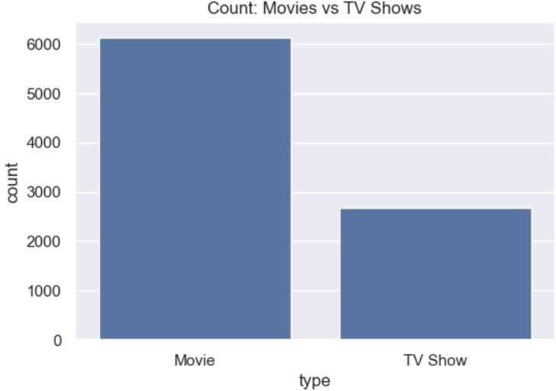
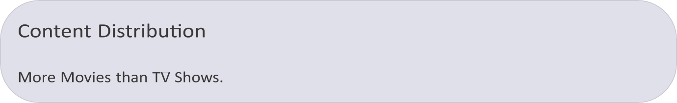
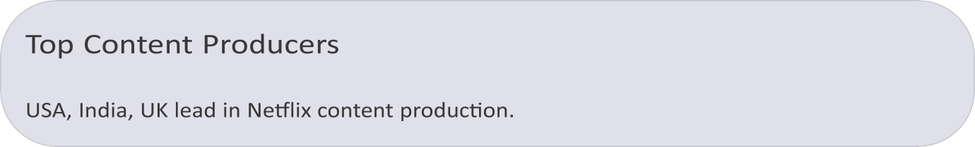
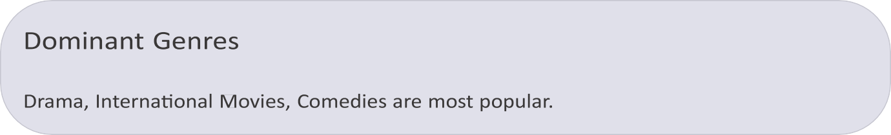
Exploratory Data Analysis (EDA) Insights
Key observations from initial data exploration:
Data Cleaning & Preparation Steps

Slide 7
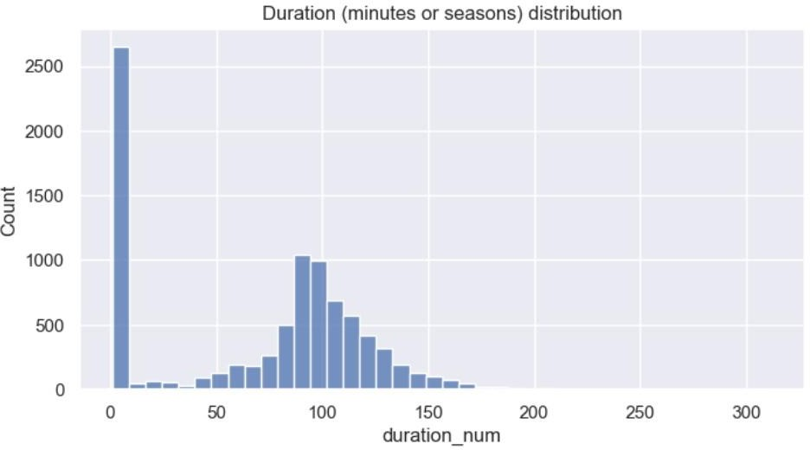
Rigorous preparation ensures data quality for modeling:
Handle Missing Values
Strategically filled null entries for completeness.
Standardize Durations
Converted "120 min" to numeric minutes for consistency.
Encode Categorical Data
OneHotEncoder for features, LabelEncoder for target variables.
Text Feature Extraction
TF-IDF applied to descriptions for semantic representation.
Split Dataset
Divided into training and testing sets for model validation.

Slide 8
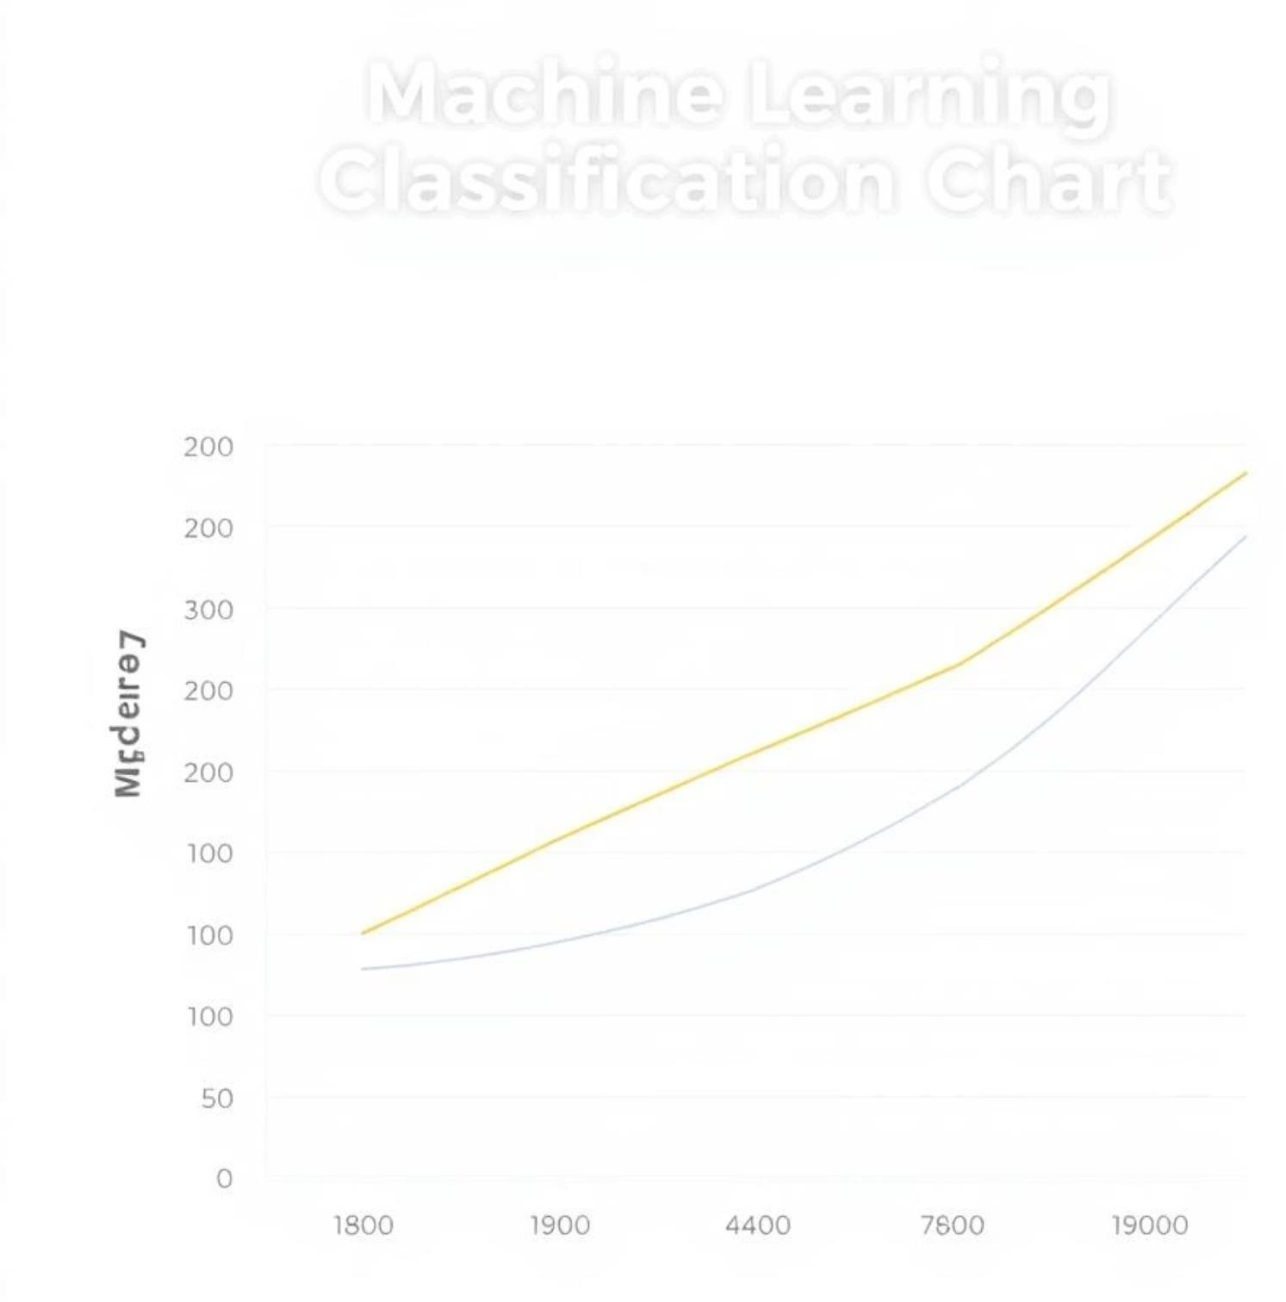
Classification Models: Movie vs. TV Show
Three machine learning models were trained to predict content type:
Logistic Regression
A baseline model for binary classification.
Random Forest
Ensemble method for robust prediction.
Gradient Boosting
Powerful algorithm for high accuracy.
Evaluation Metrics: Accuracy, Precision, Recall, and F1 Score were used to assess model performance. The model with the highest F1 Score was selected as optimal.

Slide 9

Clustering Analysis: Discovering Content Groups
K-Means clustering applied to categorize similar Netflix titles.
K-Means Algorithm
Clustered TF-IDF vectors derived from content descriptions.
Dimensionality Reduction
TruncatedSVD used for effective visualization of clusters.
Identified Clusters
Groups emerged, such as drama-focused, kids' content, and thrillers.
Cluster Quality
Silhouette score determined the cohesion and separation of clusters.

Slide 10
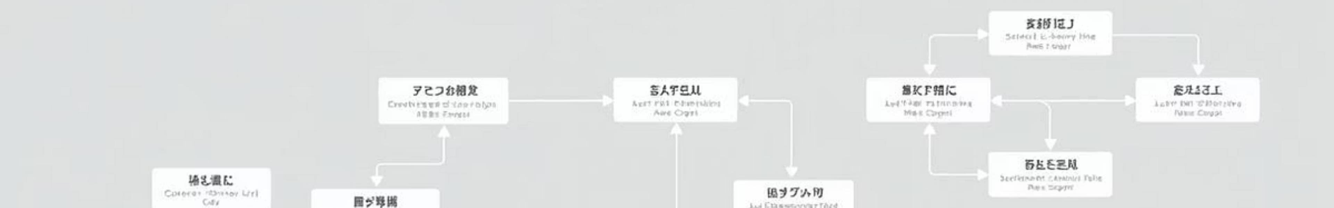
Content-Based Recommendation System
A personalized recommendation engine built on content similarity.
TF-IDF Vectors
Descriptions transformed into vectors for semantic comparison.
Cosine Similarity
Measures textual similarity between titles.
User Input
System takes a title, finds similar content.
Personalized Suggestions
Enhances user experience with Netflix-like personalization.
Deployment: Making Models Accessible
Trained models are saved for seamless integration and reusability.

Slide 11
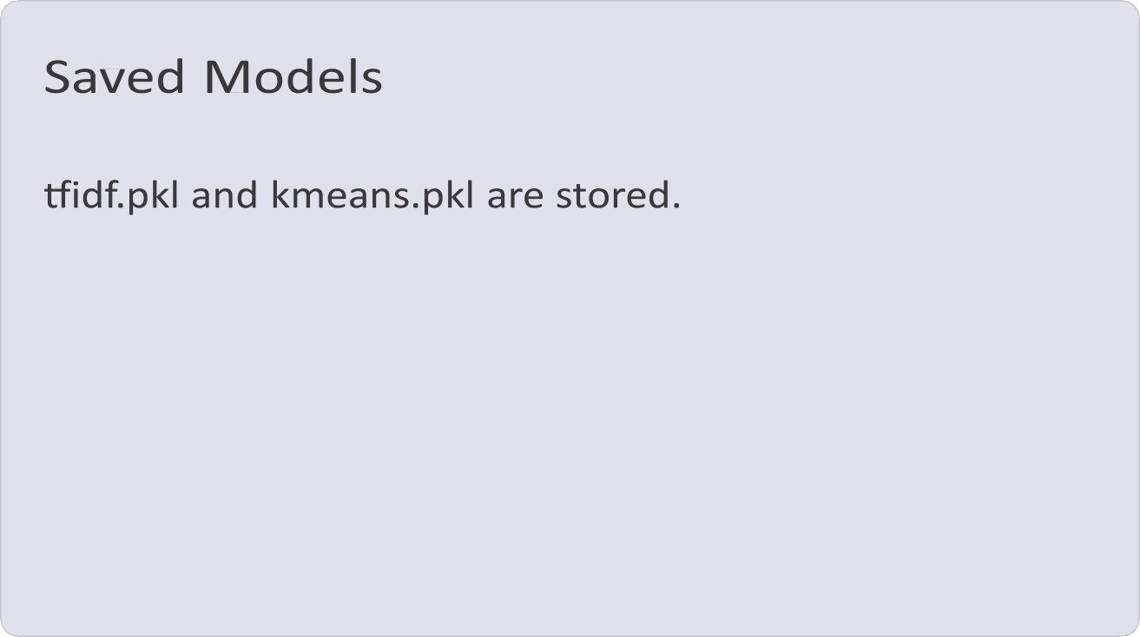







Integration Possibilities:
Web applications
Mobile applications
Recommendation APIs
Ensures that models can be utilized without the need for
retraining, streamlining future development and implementation.
THE END
THANK YOU FOR YOUR TIME

